Slide 1



SOFTWARE DEVELOPMENT PROFESSIONAL PROGRAM
The Component Lifecycle

Slide 2





The Component Lifecycle
Learning Objectives
Define and explore the component life cycle.
Contextualize React hooks within the component life cycle.
Identify the use of cleanup with the "useEffect" hook.

Slide 3

The Component Lifecycle
The Component Lifecycle
All said... React feels like a lot of work!
Why are we doing this?
Notes:
We've been insisting that React is a powerful library, but given what we have learned up until this point, you may be thinking:
"Why are we doing this?" or "This just seems like more steps to build a webpage. I can already write HTML."
And that's fair! Right now, it may look like React pages are just harder-to-write HTML webpages.
But React can be more than just organized code rendering standard user interfaces.
This lesson shines a light on how we can easily capture events and respond to them with React.
Ultimately, we will be able to build organic, responsive web apps!

Slide 4
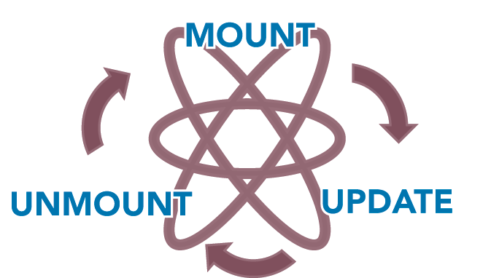
The Component Lifecycle
The Basic Component Lifecycle
Source: ThriveDX
Notes:
To capture all the power of React, it is important to understand how React handles the life cycle of components.
This is where the concept of "hooks" becomes more apparent.
Many "moments" in the life cycle of a React component can be scoped to perform a specific behavior.
This is where the term "hook" comes from. As the life cycle is "passing by," a hook may interrupt and
perform an action.
The following slides will touch on each of these life cycle events in more detail.

Slide 5



The Component Lifecycle
Mount
Renders the component
Runs all useState() hooks, typically initializing default values
Runs useEffect() hooks
Source: ThriveDX
Notes:
This is likely the life cycle stage that learners are familiar with, whether they have been using the term
"mount" or not.
<< Exercise 1 in the Lesson Companion.>>

Slide 6

The Component Lifecycle
Update
Renders the component
Runs useState() and useEffect() hooks
Runs cleanup effects
Source: ThriveDX
Notes:
You may notice the update stage contains the same steps as the mount stage. While this is true, the update stage
can also handle any cleanup effects, such as unsubscribing from a subscription, resetting or stopping timers, etc.
<< Exercise 2 in the Lesson Companion.>>

Slide 7


The Component Lifecycle
Unmount
Cleans up any effects that need a cleanup
The component is removed from the page.
Source: ThriveDX
Notes:
Only cleanup is run during unmount.

Slide 8
The Component Lifecycle
Cleanup?
We are hearing the term cleanup a lot.
Notes:
So what is cleanup?
<< next slide >>
<< Exercise 3 in the Lesson Companion. >>

Slide 9

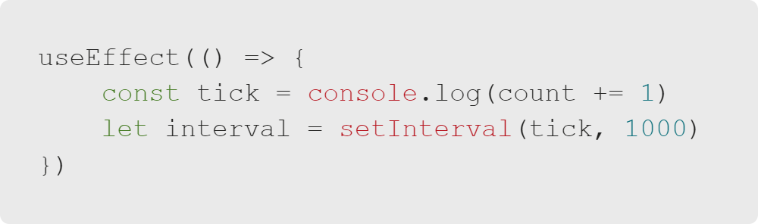
The Component Lifecycle
Cleanup
What if we set a timer in a useEffect?
Notes:
What happens to this interval when the component is unmounted? What happens if the component is re-rendered or updated?
Because we do not have cleanup, this timer will never stop ticking.

Slide 10
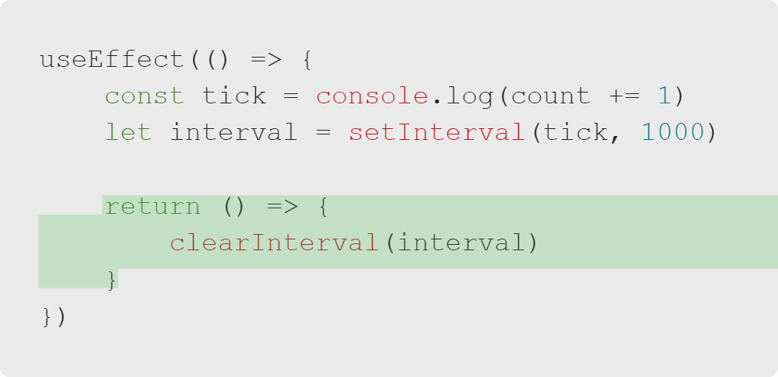
The Component Lifecycle
Cleanup
Luckily, using cleanup is very simple.
Notes:
To clean up this interval, we just need to feed a function to our 'useEffect' return value.
It may be helpful to think of this event as triggering when the component has "resolved."
This is the unmounting action occurring in real time.

Slide 11

The Component Lifecycle
Try It
Now that we have seen how to prevent memory leaks with cleanup, we will explore the component lifecycle ourselves!

